Slide 1
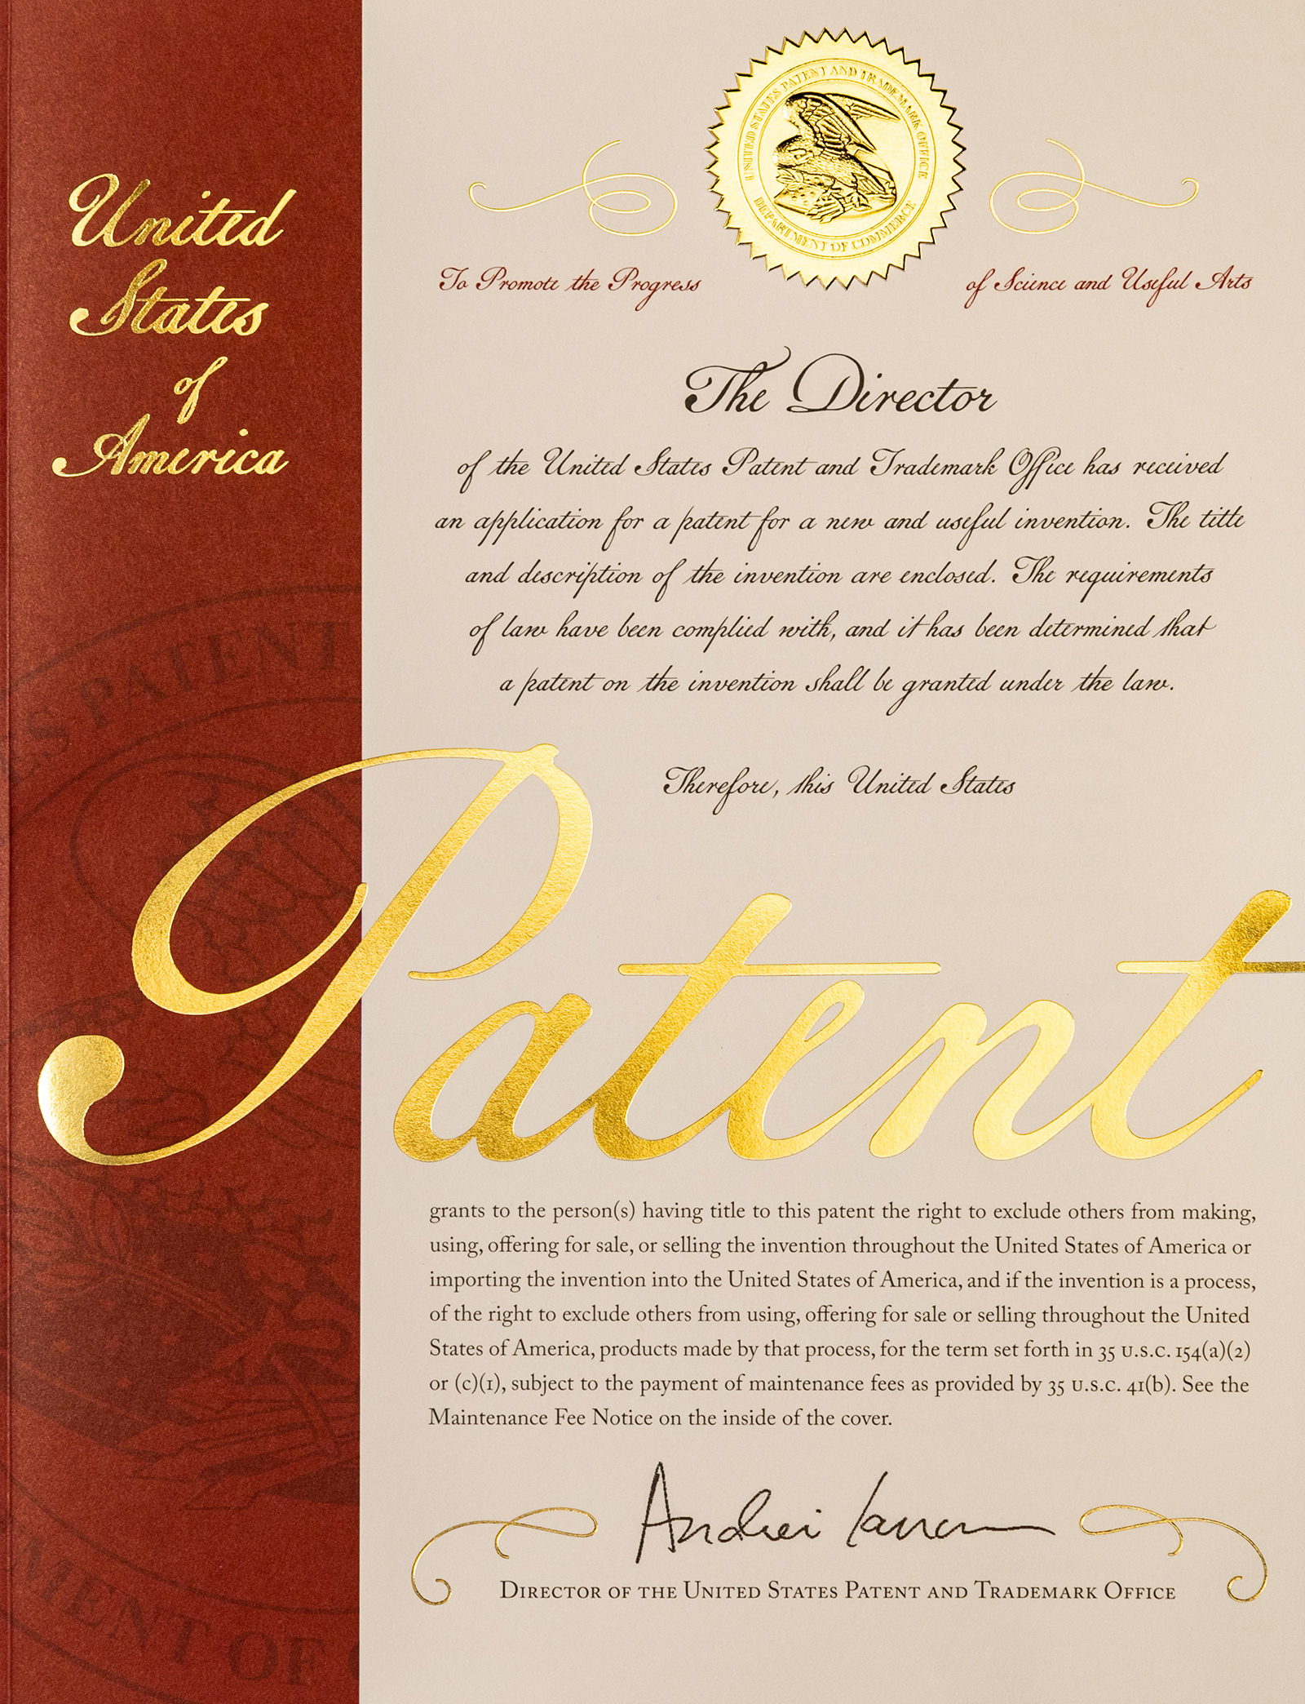
General Patent Prosecution Timeline and Activities
1 week – 12 months
12 months
3-28 months
5-66 months
//
//
1. Prior art search
2. Draft PRV or
1. Prior art search
2. Draft UTL or
1. Compile prior art for USPTO
2. Complete administrative paperwork
Patent Prosecution:
1. Restriction
2. Non-Final Action
3. Final Action
Repeat 2 & 3 until done
US patent
OR Final Rejection
Hold for research or Release technology
Hold for research or Release technology
Submit
Disclosure
File
Provisional Application
BEGIN US patent prosecution
File
Utility Application
Notes:
Throughout the whole time also– reporting to agency, inventors and partners (sometimes licensees as well)

