Slide 1
SHRA Performance APPRAISAL POLICY
Linda Mangum
Director of Employee
Relations/AAO

Slide 2
SHRA Performance Appraisal Policy
Performance Appraisal
Performance Cycle: April 1- March 31
Performance Planning (Work plan) completed within 60 days after hire, change of supervisor, part-time and time-limited start work.
Performance Appraisal completed and sent to HR by May 30th
Calibration Sessions
Weighting – Institutional Goals & Individuals Goals each equal 50%
3-Point Scale for all ratings
All SHRA Employees receive same performance document
Notes:
Roles & Responsibilities.
It is important that the employee is active in the process. The supervisor drives the process, but the employee can’t just sit back and be passive. The employee has to take ownership of their own work. Employees have to ask questions to make sure they have clarity, keep their supervisor informed when they are having difficulties.
Again, for the supervisor, it’s the clarity and honest as we’ve mentioned before. It’s also important to invest your energy upfront, to spend time crafting your expectations in the work plan and addressing issues as they come up. Example of the 10year Outstanding employee that you want to fire. Short-term pain for the long-term gain.
The second-level supervisor is responsible for reviewing the documents prior to distribution to employees in order to ensure consistency in the ratings not only all the ratings given by one supervisor but that the ratings across multiple supervisors also remain consistent, so that one supervisor isn’t giving out Goods for work at the same levels as employees reporting to a different supervisor but getting Outstandings.
Same goes for the 3-rd level supervisor.

Slide 3
Performance Management &
Expectations (Work Plan)

Slide 4
Roles & Responsibilities
SHRA Performance Appraisal Policy
Employee
Actively participate and own the work
Ask questions and keep supervisor informed
Supervisor
Clarity in expectations and honesty in appraisal
Invest time upfront and use available resources
Second-Level Supervisor
Review and sign all performance plans and performance review
Ensure expectations/ratings applied consistently
Notes:
Roles & Responsibilities.
It is important that the employee is active in the process. The supervisor drives the process, but the employee can’t just sit back and be passive. The employee has to take ownership of their own work. Employees have to ask questions to make sure they have clarity, keep their supervisor informed when they are having difficulties.
It’s also important to invest your energy upfront, to spend time crafting your expectations in the work plan and addressing issues as they come up. For example, you have a 10 year Outstanding (EE) employee that you want to fire. It will be hard to do that if you have no work plan, and conferences addressing issues as they came up. The purpose of a Performance Improvement plan is to give the employee the opportunity to know what is wrong and how to correct the poor performance.
The second-level supervisor is responsible for reviewing the documents prior to distribution to employees in order to ensure consistency in the ratings not only all the ratings given by one supervisor but that the ratings across multiple supervisors also remain consistent, so that one supervisor isn’t giving out all meeting expectations for work at the same levels as employees reporting to a different supervisor but getting exceeds expectations.
Same goes for the 3-rd level supervisor.

Slide 5
Calibration
SHRA Performance Appraisal Policy
Calibration Sessions
Communication process in which peer supervisors within a defined unit establish goals and metrics to ensure consistent application of performance expectations and ratings across similar positions.
Goal Calibration at beginning of performance cycle to review & clarify expectations for institutional goals & set individual goals
Rating Calibration at end of cycle to apply consistent, equitable & fair ratings for work performed in similar position
Notes:
Next we want to talk about re-setting expectations. Due to the changes in the program, employees are going to be rated on aspects of their work that they haven’t been rated on previously or at least not with these specific categories. When we speak with the employees, we will emphasize that their supervisors may have to change some expectations but they aren’t changing expectations just for the sake of it.
Over time, things change – budget, staffing, technology, etc. and these changes can have an affect on the positions classification and or the performance expectations. So, every once in a while, the supervisor needs to step back and decide if the current expectations are truly meeting the current business needs, or are they set too high, or set too low. We call this a recalibration, with a goal to re-establish what Good means, what meeting expectations for the business needs means.
Meeting expectations is the “Good” of the old process. Good simply means, according to the state, doing a “good job”.

Slide 6
Setting Expectations
SHRA Performance Appraisal Policy
Not Meeting
Meeting
Exceeding
R
E
A
C
T
I
V
E
PROACTIVE
Timely?
Quantity?
Accuracy?
Autonomy?
Manner?
Notes:
The work plan has a list of actions that are needed to be performed but they all may not necessarily get spelled out in a work plan (otherwise the work plan would be a hundred pages long). You will meet to think through the aspects that are most significant to you as a supervisor that you may want to articulate in the work plan or in conversation with the employee.
Timely: It gets done by the deadline. Good. If it doesn’t get done on time, then that’s a problem. Especially if it never gets done. Or, It gets done a few days in advance. Maybe that’s Very Good. It gets done a week in advance or as soon as it comes up; dust never gets a chance to settle on it. Maybe that’s outstanding.
Quantity: In this case, you’d be expected to get all essential actions done by the deadline to get a good. There’s less wiggle room there. What might happen if you don’t get an action entered? (someone might not get paid). Or, getting all the necessary items entered AND entering a few others for the next cycle might push the rating up.
Accuracy: Well, it got done on time and was entered accurately. Maybe the rare occasion of an oopsy. OR, it was entered on time, but it had significant errors in it that had to be corrected. Even worse if those errors resulted in someone not getting paid correctly or at all. Or, not only was it accurate, but the employee was proactive in anticipating errors, checking things well in advance of the deadlines so that all the information is ready to go without having to hunt it all down at the last minute.
Autonomy. Employee got it done him or herself as expected. Or, well, the employee got it done maybe even on time, but only because they spent several hours on the phone asking the help desk (or asking you or a colleague) how to do it. You have to make a distinction between a real problem and an employee who asks the same questions every biweekly and has to be hand-held throughout to get the work done. This is a drain on time and effort that could or should be spent doing other things (for both the employee and whoever is helping). Or, employee takes ownership of the work, anticipates problems, takes the lead on following through on any open issues (owning the work) and follows-up with parties regarding the outcome so that the basic expectation is completed on time.
Manner: Well, it got done, even on time, but it was a nightmare for everyone involved. The employee pounded on people’s desks demanding their information, “you get me your form by the end of today or you aren’t getting paid and that’s that”. Compared to the person who explains what they need, why or how to get it, what’s the best time for you to get this to me, a kinder gentler approach. Sometimes you have to be firm, but there is a difference between being firm and being nasty, especially if the person who is receiving the brunt of it didn’t really do anything wrong. (I want to point out here, bullying and intimidation violates the policy and the law depending on the severity and consistency) Micromanaging- an employee should be able to come to you to ask questions and receive help even among workers.
So, all of these together affect how one might be rated for this function. Not all of these items need to be worked in detail into the actual language of the principal function, otherwise, the work plan would be a hundred pages long. So, you need to decide as the supervisor which aspects are the most significant markers for you in determining the rating, and those should be discussed in the work planning conference with the employee or whenever those issues come up throughout the performance cycle.
Because this is a new process, the policy says you have up to 5 actions to be evaluated but this year you will only have to come up with 3 to make it easier for you and until you are comfortable with the new process.
Summary – 1) Align performance expectations , ratings and current business needs (“meeting expectations”)
2) Clarify distinctions between what you need. (“meeting”) and what you want (“exceeding”)

Slide 7
Weighted Goals
SHRA Performance Appraisal Policy
*No goal can be weighted lower than 5%
Notes:
The individual goals will weigh 50% and the institutional goals will weigh 50% for a total of 100% rating. Each goal will be weighted in each category to equal 50%. A goal cannot be less than 5%.

Slide 8
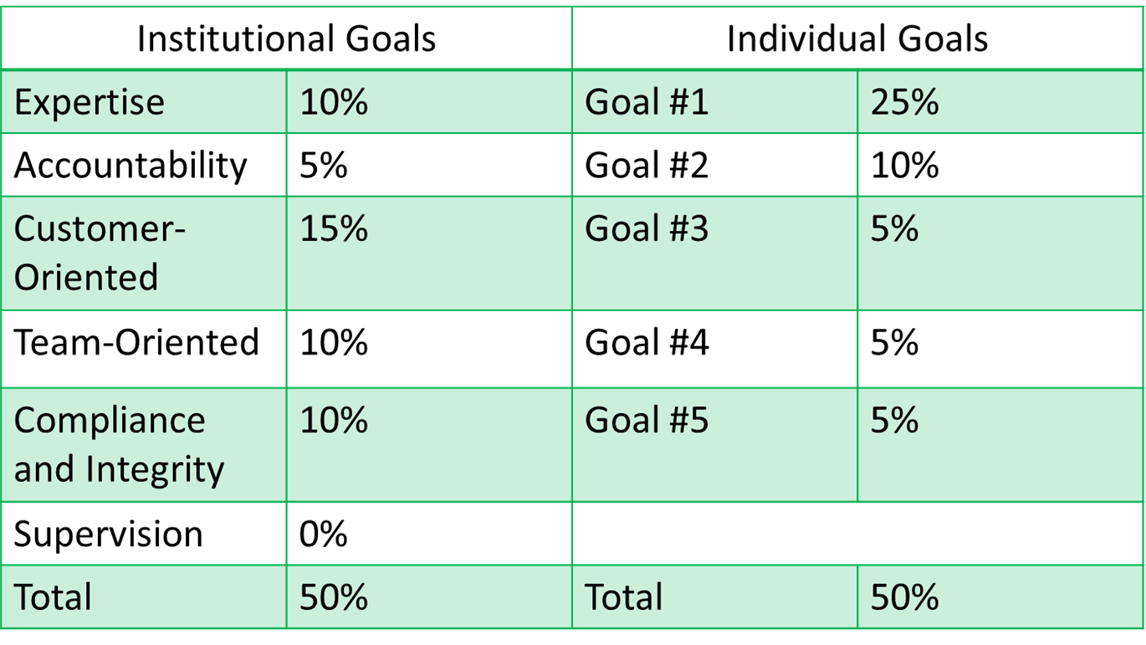
Weighted Goals Example
SHRA Performance Appraisal Policy

Slide 9
INSTITUTIONAL GOALS

Slide 10
Institutional Goals
SHRA Performance Appraisal Policy
Expertise (Quality of Work)
Precision – Work is accurate, thorough, and demonstrates sufficient analysis & decision-making to meet requirements
Resourcing – Uses materials efficiently and appropriately and documents work efficiently and appropriately
Innovation – Looks for ways to improve efficiency or quality
Development – Maintains technical skills and relevant credentials
Notes:
The first category was about the work product – this organization value is about the process by which the employee produces that product, their task management.
Core to this is producing the right volume by the established deadlines. Again, getting it done by deadline does not exceed expectation; it meets the expectation.
At the good level, we also expect that the employee can do basic juggling of their duties and priorities and make adjustments and new things come up. And, if they are not sure what to do, then they need to communicate with their supervisors to clarify priorities. I’m juggling 10 balls and I need to know which ones you want first. If there are roadblocks to getting work done, then it is the responsibility of the employee to keep the supervisor informed so that if adjustments or intervention need to occur, there is time to do that.
The last bullet gets toward the rowboat scenario. Functioning at the good level means that the employee should not need a lot of oversight or assistance in completing the work assigned for them to do. Everybody gets swamped now and then, everyone needs a little help now and then, but it shouldn’t become the standard practice that someone has to bail out the employee at the last minute to meet the deadlines. That causes drag on the organization.

Slide 11
Institutional Goals
SHRA Performance Appraisal Policy
Accountability (Task Management)
Productivity – Completes required volume of work by deadline and stays productive
Autonomy – Generally completes work with few reminders and/or infrequent oversight
Prioritizing – Takes appropriate measures to plan and organize work, prioritize tasks and set realistic goals
Coordination – Seeks needed information to complete work and is timely in communicating status with relevant parties
Notes:
The first category was about the work product – this organization value is about the process by which the employee produces that product, their task management.
Core to this is producing the right volume by the established deadlines. Again, getting it done by deadline does not exceed expectation; it meets the expectation.
At the good level, we also expect that the employee can do basic juggling of their duties and priorities and make adjustments and new things come up. And, if they are not sure what to do, then they need to communicate with their supervisors to clarify priorities. I’m juggling 10 balls and I need to know which ones you want first. If there are roadblocks to getting work done, then it is the responsibility of the employee to keep the supervisor informed so that if adjustments or intervention need to occur, there is time to do that.
The last bullet gets toward the rowboat scenario. Functioning at the good level means that the employee should not need a lot of oversight or assistance in completing the work assigned for them to do. Everybody gets swamped now and then, everyone needs a little help now and then, but it shouldn’t become the standard practice that someone has to bail out the employee at the last minute to meet the deadlines. That causes drag on the organization.

Slide 12
Institutional Goals
SHRA Performance Appraisal Policy
Customer-Oriented (Customer Oriented/Communication)
Clarity – Listens to determine the most effective way to address customer needs and concerns
Awareness – Shows solid understanding of customer needs and seeks customer input
Attentiveness – Follows through on commitments, despite obstacles
Diplomacy – Maintains professional and respectful tone during difficult situations
Notes:
We’ve had several cases where an employee is great to work with, really good person, but you don’t really want to have them working directly with the customers. And we’ve had the flip-side: fantastic with the customers, but Holy Heck with their co-workers. So we have broken out the behavioral values between external customers (and that can include customers in the department) and internal teammates.

Slide 13
Institutional Goals
SHRA Performance Appraisal Policy
Team-Oriented (Team Work and Collegiality/Work Schedule & Attendance)
Collegiality – Communicates and engages directly, clearly, and tactfully with colleagues
Collaboration – Provides feedback and healthy dialogue on performance and operational issues
Contribution – Makes decisions with others in mind, willingly performs additional duties as required by management to meet business needs
Attendance – Absences are infrequent and don’t place an undue burden on department
Notes:
The next value is about the internal communication and behavior with co-workers.
--Communicating clearly and tactfully; respecting diversity and differing viewpoints.
--Sharing resources – not being a resource hog.

Slide 14
Institutional Goals
SHRA Performance Appraisal Policy
Compliance & Integrity (Policy & Safety Compliance)
Policy – Complies with personnel and equal opportunity policies, including prohibitions on harassment, discrimination, and workplace violence, and all other policies
Safety – Complies with all safety requirements for the position
Ethics – Chooses ethical action, even under pressure, avoids situations that are inappropriate or that present a conflict of interest
Respect – Appreciates individual and cultural differences and treats all people with dignity and respect
Notes:
This value covers all policy-related issues and gives us a place to mark policy violations and related conduct issues in the evaluation.
-Adhering to personnel policies and following confidentiality policies, FERPA, HIPAA, etc.
-Complying with department policies as well as industry standard practices or other external rules or regulations.
-Some areas of campus have a higher level of criticality with safety issues, such as the facilities and lab environments, so following those procedures.
-And the final bullet covers the rest of campus policies and resource maintenance, following IT security and use, proper use of university property and financial resources, etc.

Slide 15
Institutional Goals
SHRA Performance Appraisal Policy
Supervision (if applicable)
Oversight- Provides adequate stewardship of assigned resources, including budget, space, equipment, and staffing
Goalsetting – Provides clear objectives that foster work unit development
Talent Management – Provides candid, timely and constructive feedback on performance and behavior, hires staff with qualities and skillsets for success
Leading – Serves as a role model and engenders trust, commitment and civility
Notes:
The last organizational value is for supervisors and covers four key indicators of appropriate supervision. Adequate stewardship of resources, setting goals, giving constructive feedback and taking corrective action as needed, and leading by example.

Slide 16
INDIVIDUAL GOALS

Slide 17
Individual Goals
SHRA Performance Appraisal Policy
3-5 Individual Goals defined each year
Organizational Goals
Work Unit Goals
Individual/Based Goals
Not intended to cover all aspects of employee work product
Focus on key results and outcomes, not steps in the process
Clarify not meeting, meeting, and exceeding expectations
Notes:
What we are looking for is 3-5 big ticket items for this performance cycle. They may be the 3-5 most critical items from the old work plan, if that makes sense to do. They could be new goals just for this performance cycle. For example, everyone in HR and Finance may have a goal of getting up to speed with People Admin before the end of the cycle. Since this is the first time in this policy, you can select three (3) critical items.
So, supervisors can set individual goals for employees, or team-wide goals, or there may be goals that everyone in the department or school may have in their work plan. Focus on the deliverables – what will the end product look like – you may have other documentation that gets into the details on the day-to-day aspects of the work.
Also give employees an idea of what level of performance is necessary for meeting, exceeding or not meeting expectations. For example, in the Development areas, there may be a goal of x amount of dollars to meet expectations, and then maybe a higher amount to exceed expectations.
During the work planning conferences with the employee, we recommend keeping the position description handy when talking with the employee, especially when discussing the organizational values so that if the employee has questions about how particular job duties will be assessed against the values, you have all the information available to help the discussion.
Again if you have good information on your current work plans, you don’t have to throw it out. If it is still useful information, keep using it; it just won’t be considered the official work plan but it can be a supplement to the work plan. Official policies or procedures can be a supplement.
Again, not everything will be captured in the work plan. Additional clarity can always be provided throughout the year as needed. Document it with an email. For example, “We spoke yesterday about the new requirements for salary reporting and agreed that due to the new expectations, the requests need to be submitted no later than the first Monday of the month rather than the second Monday.”

Slide 18
Sample Goal: Outreach Initiative
SHRA Performance Appraisal Policy
How would we write a goal for an HR Consultant to develop an Outreach Initiative for campus?
Specific (What needs to be accomplished? What outcomes?)
Measurable (What data can be used to define success?)
Achievable (Is this challenging, but realistic?)
Relevant (Does this align with broader goals/needs?)
Time-bound (What are the deadlines/Milestones?)
Expectations (Is it ethical, exciting, and enjoyable?)
Resources (What assistance will be provided for this?)
Notes:
Regardless of the position, use this smarter guideline to write a goal for your positions.

Slide 19
Sample Goal: PM Consultations
SHRA Performance Appraisal Policy
Goal #2: PM Consultations
Achieve proficiency in new performance management program by October 30, 2020 …
in order to provide appropriate consultation to supervisors and employees on required and preferred application of processes …
so that supervisors and employees can benefit from the new program and succeed in meeting or exceeding their goals

Slide 20
Sample Goal: PM Consultations
SHRA Performance Appraisal Policy
Specific Deliverables
Review performance plans / position descriptions to provide useful and appropriate suggestions on applying institutional goals to specific job duties and crafting strategically-aligned individual goals
Review disciplinary actions to determine which goal(s) will be affected in the appraisal. Selection should be based on the cause of the problem instead of an effect
Provide guidance on written overall comments and determining appropriate overall ratings

Slide 21
Sample Goal: Procedural Projects
SHRA Performance Appraisal Policy
Exceeding Expectations
Explaining (in)frequent variations that may require differing approaches or different severity of discipline;
Reviewing past related actions in disciplinary database to evaluate and describe consistency/appropriateness of past actions;
Providing suggestions for related process improvements; and/or
Completing additional projects.

Slide 22
SHRA Performance Management
Talent Development Plan

Slide 23
Talent Development Plan
SHRA Performance Appraisal Policy
Development Goals specifically designed for person, not position:
Employee’s personal career goals
Growth opportunities within unit or University
Developing/sustaining competencies needed in current position or employee’s career path
It is recommended/expected that each employee has at least one development activity over a 12-month period.
Notes:
There is space in the work plan document to list any activities for the performance cycle.
Development goals are not required, however, we are an institution of higher learning, so it is recommended/expected that each employee has at least one development activity over a 12-month period.

Slide 24
Talent Development Plan
SHRA Performance Appraisal Policy
Examples:
Required/career-path credentials/certifications
Work-related skill development/refreshers
Academic coursework or continuing education
Recommended for all employees (Expected for Not Meeting):
At least one development activity

Slide 25
Corrective Action Plan/Performance Improvement Plan
SHRA Performance Appraisal Policy
Mandatory if:
If the overall rating or the ratings on one or more institutional goals or individual goals does “Not Meet Expectations” on any appraisal; or
Employee must acquire new knowledge or skill to maintain performance at or above “Meets Expectations" level or achieve competency level required for position
Define in the annual appraisal and carry over to the Talent Development Plan for the next cycle.
Notes:
This is the same as a Performance Improvement Plan, going forward we will be calling it that.
Development goals are required as part of the corrective action plan if the employee received does not meet expectations on their last appraisal. The goals would be whatever corrective action has been determined to happen in order to correct the deficiencies. Development goals may also be required in order for the employee to maintain skillsets necessary for the position.

Slide 26
SHRA Performance Management
Talent Development
Plan

Slide 27
Performance Planning Conference
SHRA Performance Appraisal Policy
Preparation
Supervisor writes/edits performance plan
2nd-level supervisor reviews/signs
Suggested: Provide performance plan prior to conference
Performance Planning Conference
Supervisor meets with employee to discuss (required)
Discuss each Individual/Institutional Goal (revise if needed)

Slide 28
Performance Appraisal
SHRA Performance Appraisal Policy
Annual performance appraisals: Cycle ends March 31
Appraisal Due: April 30 (no later than)
Supervisor: Writes/edits appraisal
2nd-Level Supervisor: Quality Control
Covers totality of performance cycle
Preparation:
May request self-evaluation/report from employee
Suggested: Appraisal provided in advance
Employee must have worked for the State at least 6 months to receive annual appraisal
Notes:
Departments may set earlier deadlines in order to give time to the second-level supervisor to review before giving to the employee by the end of May, so you should plan to start your review gathering and writing by late April and have your final draft done by Mid-May.
The second-level supervisor is responsible for consistency across supervisors and to give a second look on clarity and supportability of the comments and ratings. Immediate supervisor, it is to your advantage to be sure that your supervisor is on board with you and the eval before you give it to the employee.
The performance cycle is 12 months, so you are evaluating 12 months of work, not just what happened yesterday or last week. So you can discuss things like, work was much stronger in a particular area the first half of the year (maybe EE (VG) and not as strong the second half of the year (maybe ME level), (Good) so the overall rating should reflect the composite of the two.

Slide 29
Performance Appraisal
SHRA Performance Appraisal Policy
Rate performance based on expectations
Give strong specific examples that reflect overall work
Avoid nit-picking minor infractions
Use more observation and less inference
Take steps to avoid rater bias
Emphasize work performed above and below “Meets” level
Overall performance comments
“Wrap-up” statement of overall contribution
May address achievements or concerns that fall outside Goals
Must hold a one-on-one review session with each employee
Notes:
Due to the space available on the form, you can skew your comments to the issues that are above or below the ME (Good) level. For items that meet the expectation (“GOOD”) you can make a brief comment that expectations as noted in work plan were met. Since that info is right there, you don’t have to repeat it. So, focus on what was above bar and below bar in the written comments. Ask yourself: What specifically is driving this rating?

Slide 30
Performance Appraisal
SHRA Performance Appraisal Policy
If a Disciplinary Action Was Issued During Performance Cycle:
“Not Meeting Expectations” for Goal(s) relevant to active disciplinary action
Despite overall rating, employee cannot receive overall rating of “Exceeds Expectations” with any ratings of “Not Meeting Expectations”
Notes:
Look at it like this: if you had to go through all the formal processes to issue an action which, a diverted your time and energy away from other work to be completed, then the employee has failed to meet expectations at least for that function.
Conversely, if you’ve been having continued conversation with an employee about sub-Good performance and that’s been going on and documented for more than six months, then you need to formalize that with a disciplinary action.

Slide 31
Performance Appraisal
SHRA Performance Appraisal Policy
Sustained Performance Deficiency:
Has “Not Meeting Expectations” (overall rating or same goal) …
For two or more performance reviews (mid-cycle or annual) …
Spanning at least six months
Then results in performance-based disciplinary action if no action has already been taken to address the issue(s) in that timeframe

Slide 32
Performance Appraisal
SHRA Performance Appraisal Policy
Off-Cycle Reviews
Interim Reviews- Completed near the middle of cycle (October)
Probationary Reviews- Completed quarterly
Other Reviews- Employee may request at least 60 days after last review once a cycle.
Transfer Reviews- Completed when supervisor or employee transfers
Employee Response
Employee responds check box and attach.
Can be attached to the appraisal document at anytime
There is no deadline, but normally completed within two weeks of review
Appeal deadline is 15 calendar days for only overall rating of Not Meeting Exectations
Facilitated discussion for NME for any goal
Notes:
These are the various cycles you will need to adhere to. If an employee is transferring from your department, complete the review, interview, etc. and send it to the new supervisor.

Slide 33
SHRA Performance Management
Appraisal Scoring

Slide 34
Appraisal Scoring
SHRA Performance Appraisal Policy
Institutional Goal and Individual Goal Scores
3 = Exceeding Expectations
2 = Meeting Expectations
1 = Not Meeting Expectations
Final Overall Rating
2.70 to 3.00 = Exceeding Expectations *
1.70 to 2.69 = Meeting Expectations
1.00 to 1.69 = Not Meeting Expectations
*If received disciplinary action and/or any rating of “Not Meeting,” then Final Overall Rating cannot be higher than “Meeting.”

Slide 35
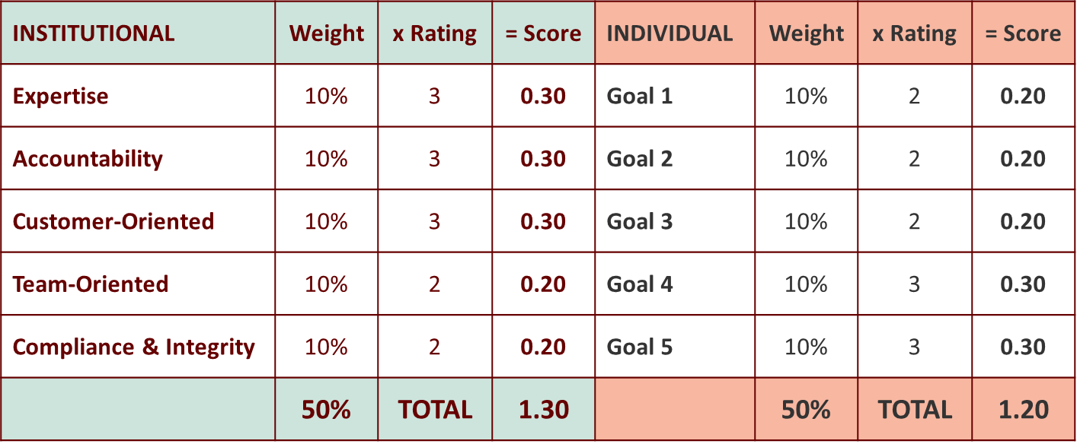
Appraisal Scoring
SHRA Performance Appraisal Policy
Overall Score: 1.30 + 1.20 = 2.50
Meeting Expectations

Slide 36
Manager/Supervisor
SHRA Performance Appraisal Policy
If a manager/supervisor fails to complete the appraisal process and/or submit a final overall rating, then the next level supervisor shall provide information.
The manager/supervisor’s failure to execute their performance management requirements shall be addressed in their annual appraisal and if necessary through SHRA Disciplinary Policy or other applicable corrective processes for SHRA/EHRA managers/supervisors.
Managers/supervisors who are newly assigned, hired or promoted into a manager/supervisor role within the first three months of entry into their role.
Notes:
There is a consequence if you as manager/supervisor do not complete an evaluation. If the immediate supervisor needs to complete it and the immediate supervisors evaluation will have a negative evaluation for failure to complete the evaluation.

Slide 37
Additional Info
Management Development Symposium
Document, Document, Document
Performance evaluations should reflect performance and conduct deficiencies.
The evaluation is used in hearing and court cases.
It is important to communicate with your employee about their performance and take disciplinary action as soon as possible.
An employee should not write their evaluation, they should be a part of the process.

Slide 38
Resources
SHRA Performance Appraisal Policy
Performance Appraisal training – all newly assigned, hired or promoted managers/supervisors are to be trained within the first three months of entry of your role
On-line Resources – Division of Human Resources
Toolkits
Performance Management Disciplinary Action Course
https://hub.ncat.edu/administration/human-resources/employee-relations/performance-management.php

Slide 39
SHRA Performance Appraisal Policy

