Slide 1
Employee Engagement Survey

Slide 2
Employee Engagement Survey
Overview
University of North Carolina System will launch the second iteration of its system-wide employee engagement survey on February 4, 2020.
Baseline survey was conducted in 2018 to create a longitudinal view of faculty and staff.
Data from 2018 was shared with UNC Board of Governors.
Employee Engagement Survey will be conducted again by ModernThink

Slide 3
Overview
Employee Engagement Survey
Employee Engagement Survey will be distributed to all permanent, full time faculty and staff.
Survey participation is voluntary and completely confidential.
Survey takes on average about 20-25 minutes to complete.
Faculty and staff can take the survey either on work time or off work time using a laptop or mobile device.

Slide 4
Survey Results

Slide 5
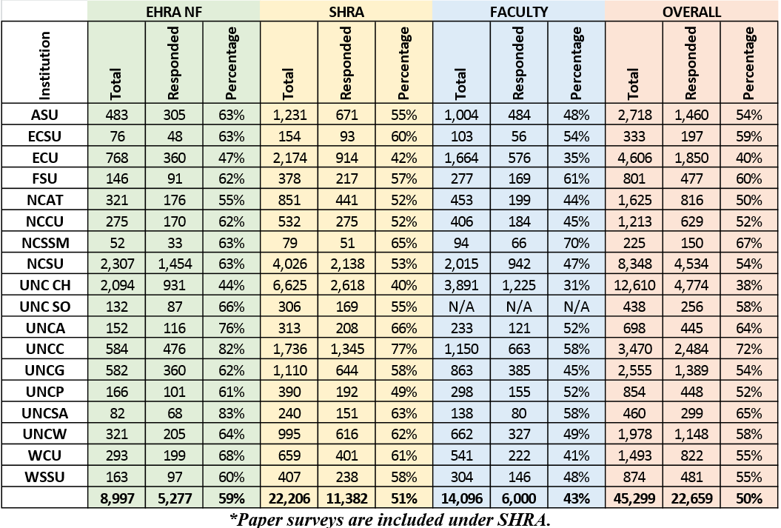
Core Population Response Rates

Slide 6
Participation Rates and Positive Engagement Ratings with Benchmarks
Institution | Participation
UNC Charlotte | 71 %
NCSSM | 67 %
UNCSA | 65 %
FSU | 60 %
UNC Asheville | 60 %
ECSU | 59 %
System Office | 58 %
UNC Wilmington | 58 %
WCU | 55 %
WSSU | 55 %
Appalachian | 54 %
NC State | 54 %
UNC Greensboro | 54 %
NCCU | 52 %
UNC Pembroke | 52 %
N.C. A&T | 50 %
ECU | 38 %
UNC-CH | 37 %
UNC System Avg Participation 2018
NC A&T Participation Goal 2020
Institution | Positive Rating
NCSSM | 69 %
WCU | 68 %
NC State | 65 %
UNC Charlotte | 65 %
UNC Greensboro | 65 %
UNC Pembroke | 65 %
UNC Asheville | 63 %
Appalachian | 62 %
UNC-CH | 62 %
UNCSA | 62 %
UNC Wilmington | 62 %
N.C. A&T | 61 %
System Office | 61 %
FSU | 60 %
ECU | 58 %
NCCU | 56 %
WSSU | 53 %
ECSU | 48 %
50%
53%
UNC System Avg Positive Rating
NC A&T Positive Rating Goal 2020
63%
65%
ModernThink Median Benchmarks
4-Year Public
4-Year Southeast
61%
All Great Colleges
46%
35%

Slide 7
Results from the Survey in 2018
What are we doing right?
Job Satisfaction – 68%
Professional Development 66%
Pride 78%
Supervisor/Department Chairs 67%
What are the focus areas?
Respect and Appreciation 55%
Collaboration 52%
Shared Governance 55%
Communication 49%
Campus Participation: 50%
Next Employee Engagement Survey
February 2020
Notes:
Total

Slide 8
Collaboration, Communication, Innovation, Appreciation and Improving Employee Engagement
University In Actions
Manager Development Program
Field Officer Training, Field Coordinator Training, Front line supervisor training
Celebrate Achievements
Cross Functional Meetings
Coffee with the Vice Chancellor
Awards and Recognition Program
Employee Appreciation Program
Newsletter “Good News”
Recognize each employees' birthday
Monthly and Quarterly Team Meetings
Team Building Retreats
Health, Finance and Wellness Program
Multicultural Center Events
New Department Onboarding Program
Deans and Chairs Development Sessions
Faculty and Employee of the month
Enhancing the work environment
Faculty and Student Engagement

Slide 9
Employee Engagement Survey
Engagement Schedule
2018 – Original Engagement Survey – All Employees/Completed
2020 – Biannual Engagement Survey – All Employees/February 4 - 18
2022 – Final GA Engagement Survey – All Employees

Slide 10
Questions and Dialogue

