Slide 1
Skype for Business
Sara Nevedal – Technology Trainer
(Adapted from the Skype for Business Quick Start Series for NCAT Faculty, Staff and Students.)

Slide 2
Audio Setup and Making Calls
Contacts, Presence and IM
Meetings
Video
Sharing or Collaboration

Slide 3

Audio Setup and Making Calls

Slide 4
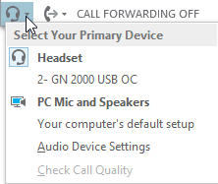
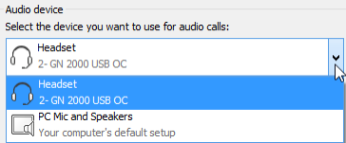
Set up your audio device
1
3
2
Select the headset or computer icon in lower left corner
Click “Audio Device Settings”
Pick your preferred audio device

Slide 5


Start a Call
1
2
…
Hoover over a contact picture
Click the call button

Slide 6
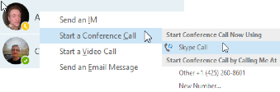


Start a Conference Call
1
2
3
Select multiple contacts (hold the ctrl key while clicking the names)
Right-click any of the selected names and choose “Start a Conference Call”
Click “Skype Call”

Slide 7

Answer a Call
When someone calls you, an alert pops up in the lower-right of your screen.
To answer the call, click anywhere on the photo area.
To reject the call, click Ignore.
To respond with an IM or change your status to
Do Not Disturb, press options.
1
Sara Nevedal
Technology Trainer
3
2
Options  Ignore

Slide 8
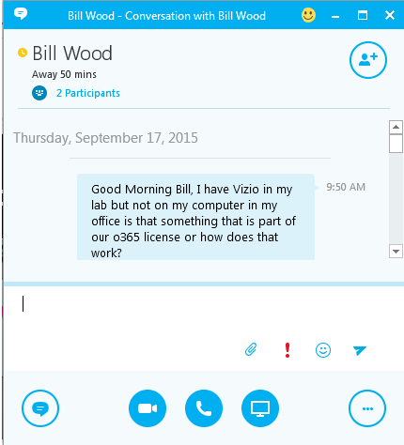

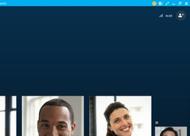
Invite more people to the chat or call
Whether it is an IM conversation, audio call or video conference, to add more people press the add symbol in the upper right corner.
In the meeting pane click:
In the participants pane click:
Select or multi-select (Ctrl-click) from your contacts, or type their name in the search field.
Press “ok” to send them a request to join the call.
Invite More People

Slide 9
Add audio to an IM conversation
In the conversation window, click the Phone button.

Slide 10
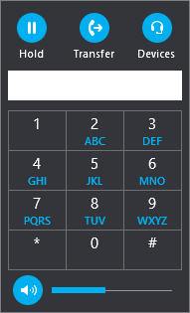
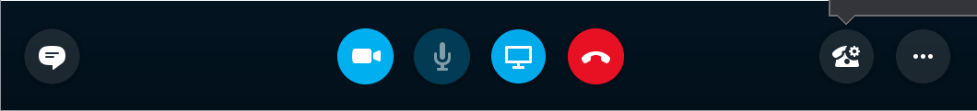
Use audio call controls
2
3
During a call:
Press the audio call controls icon to access controls.
Press “Hold” to place the caller on hold.
Press transfer and then select the desired number to transfer your caller.
To hang up, press the red Phone button.
1
4

Slide 11

Contacts, Presence and IM

Slide 12
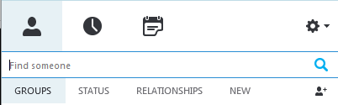
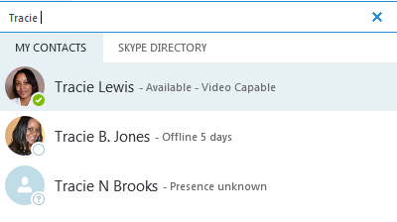
Find someone
Connect with someone at NCAT or someone outside the University that has a Skype account.
Type a name in the search box. (tabs below will change)
If the person is faculty member, staff member or student at NCAT, stay in the “My Contacts” tab.
If not, click on the “Skype Directory” tab to look them up.
1
3
2

Slide 13
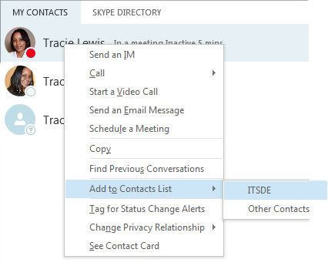
Add a contact
Once you find someone, add them to your contacts list for quick access.
Right-click the name in the search results.
Click add to contact list.
Pick a group to add your new contact to.
1
2
3

Slide 14
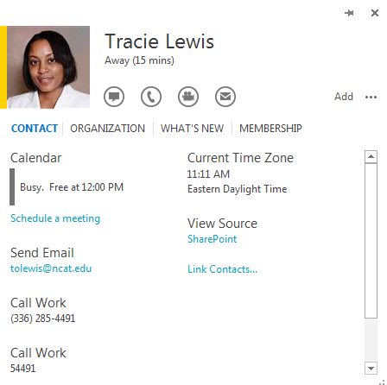

View a contact card
1
2
Tap a contact picture.
Tap the contact card button to open their card.

Slide 15

Create a group
1
Set up a group for each team you work with so you can quickly see who is available, or communicate with the entire team at once.
Click the Add a Contact button
Select Create a New Group.
Begin typing your new group name.
2

Slide 16
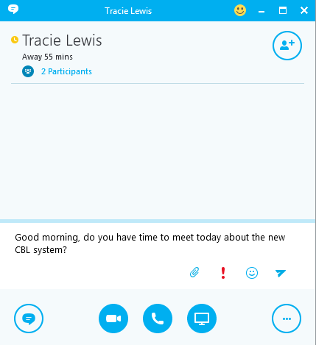
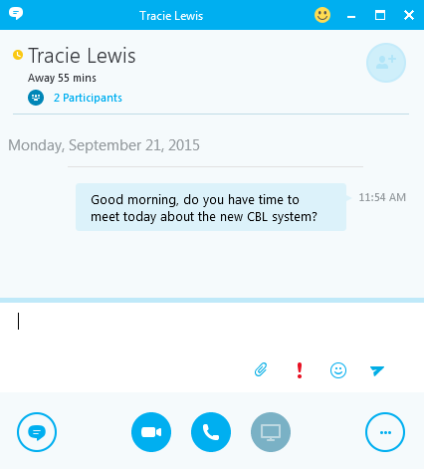
Instant messages
1
2
Use IM (instant messaging) to touch base with your contacts right away.
Point at a contact
Press the IM button next to their name (or Crtl-click more than one contact and press the IM button at the bottom of the window.)
Type your message and press Enter on your keyboard.
3

Slide 17

Add audio, video and share files
Explore these options, while chatting, at the bottom of your IM window.
Add audio
More options
Add video
Share your desktop
or a specific program

Slide 18
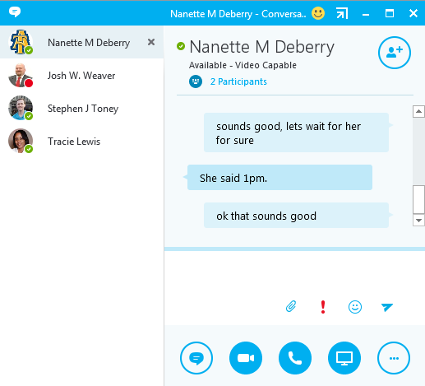
Switch Between Conversations
If you have several conversations going on at the same time, Skype for Business displays them all in one window, so you can toggle between them.
Click on contacts to toggle
between conversations

Slide 19
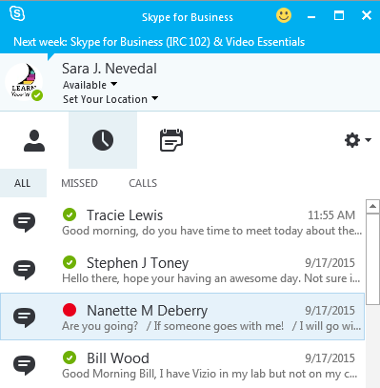
Find a previous IM conversation
Skype for Business automatically saves your IM conversation history. To view or continue a previous conversation as well as see any requests you may have missed:
Click the Conversations tab. (clock icon)
Click the All or Missed tabs.
Double Click the conversation you wish to open.
1
2
3

Slide 20
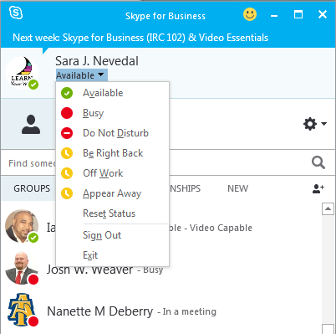
Set your availability status (Presence)
Presence is a quick way to let others know if you are available to chat.
Click status drop down list right below your name in main Skype for Business window.
Choose desired presence. (Status automatically changes if you are busy on your calendar or using PowerPoint to present on your computer.)

Slide 21

Meetings

Slide 22
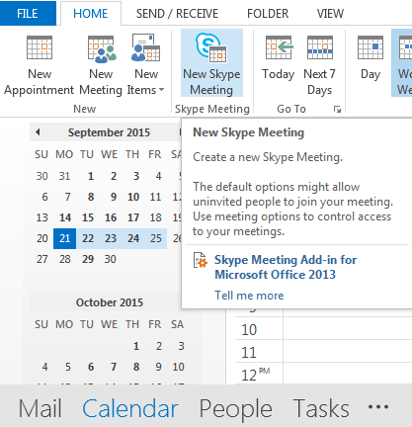
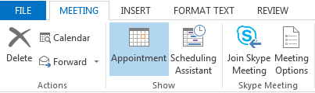
Schedule a Skype for Business meeting
In Outlook Desktop Application:
3
Open your Outlook Calendar.
Navigate to the Home tab.
Choose New Skype Meeting. Complete the meeting request like you normally would.
Set meeting options.
2
4
1

Slide 23
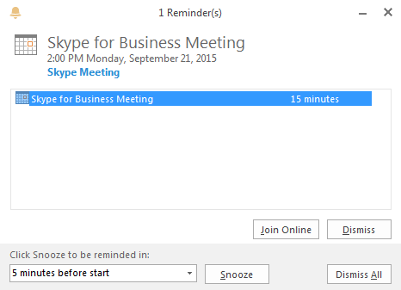
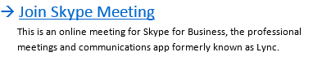
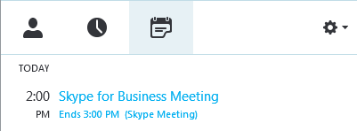
Join a Skype for Business Meeting
3 ways to join the meeting:
3
Open your Outlook Calendar, Double Click on Meeting, click on Join Skype Meeting.
In the main Skype for Business window double click the meeting listed in the Meetings tab. (calendar icon)
Select Join Online in the Outlook reminder pop-up window.
1
2

Slide 24
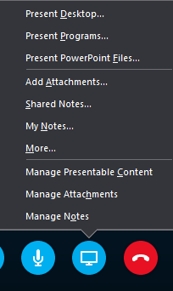
Share your desktop or a program
2
Need to show everyone what you are talking about?
In the meeting window, click the Present button.
Click Present Desktop to show the entire contents of the desktop window. To just show activity in one program, click Present Program and double click your program.
1

Slide 25
Share a PowerPoint Presentation
1
In the meeting window, click the Present PowerPoint Files button.
Browse to the PowerPoint presentation file you wish to present and click OK.

Slide 26
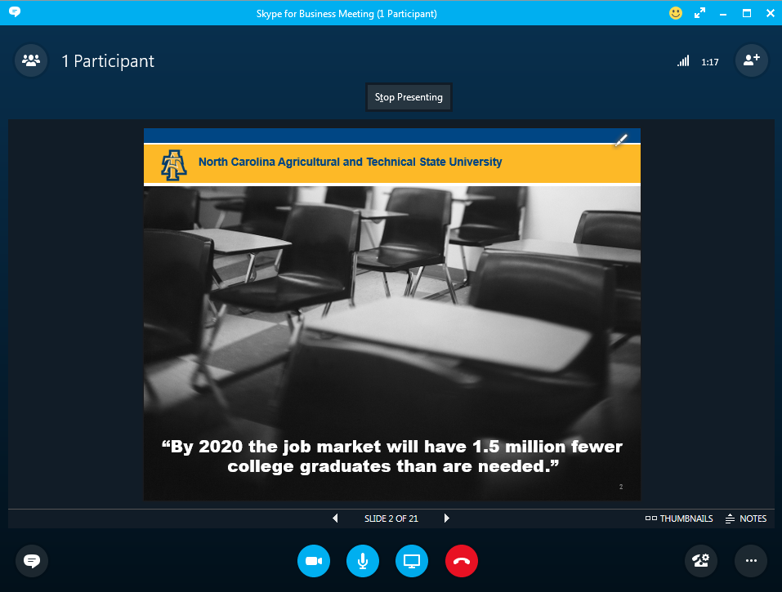
Share a PowerPoint Presentation
Press Stop Presenting to end your presentation.
Advance to next slide
Access thumbnails and presenter notes. (Only visible to you)
1
3
2

Slide 27

Record and play back a meeting
2
3
Click the More Options button.
Click Start Recording.
After the meeting, click the More Options button and choose Manage Recordings to publish, play, rename or delete the recording.
1

Slide 28
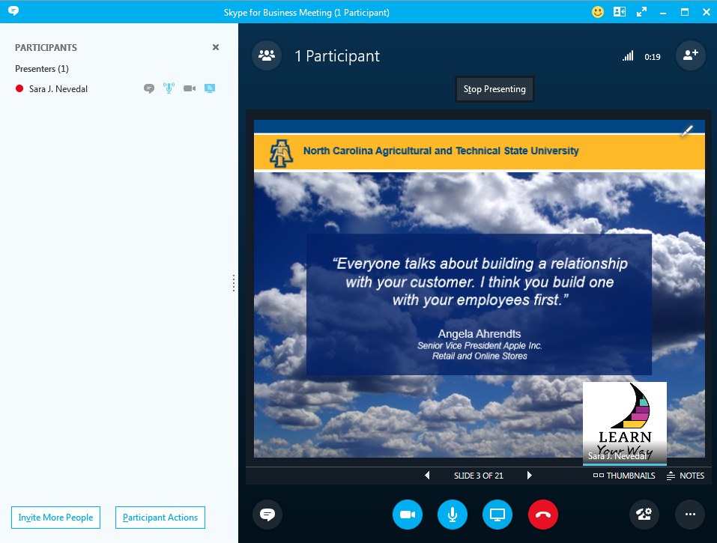
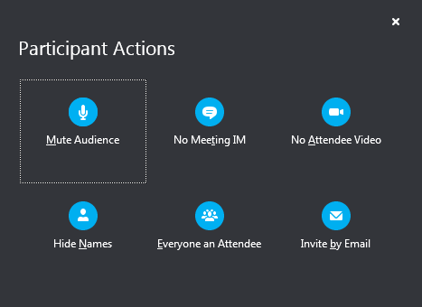
Manage meeting participants
1
Click the Participants button to open the participants pane so you can see a list of everyone in the meeting.
Click the Participant Actions button.
Click one or multiple buttons to apply these settings to attendees.
Click Invite More People button to add participants.
3
4
2

Slide 29

Video

Slide 30
Start a Video Call
1
2
…
Hoover over a contact picture
Click the Video button (You can transform an IM or audio conversation into a video chat
by pressing the Video button during the conversation.)

Slide 31

Sharing and Collaboration

Slide 32
Share your desktop or a program
2
Need to show everyone what you are talking about?
In the meeting window, click the Present button.
Click Present Desktop to show the entire contents of the desktop window. To just show activity in one program,
click Present Program and double click your program.
1

Slide 33
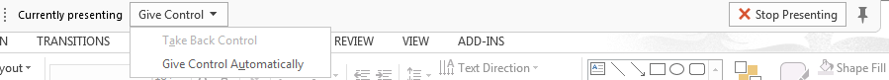
Share a program
1
2
If you share a program, it will have a yellow border and a Now Presenting tab on your desktop.
To stop sharing, click Stop Presenting on the bar at the top of your screen or at the top of the conversation window.

Slide 34
Allow another participant to take control
1
2
Click Give Control to allow another participant to drive your computer.
To take back control, click Give Control on the bar and choose Take Back Control from the drop down list.

Slide 35
Share a file or a picture
1
Drag files
here to
Share
If you are in a two person impromptu meeting the simplest way to share a document or photo is to drag and drop the file into the IM area or to the participants name.
If you are in a scheduled meeting press Present button then choose: Add Attachment.
2
2

Slide 36
Share notes with OneNote
Drag files
here to
Share
In the conversation window, press the Present button then choose: Shared Notes.
Select an existing notebook, or click New Notebook to create a new one.
1

Slide 37
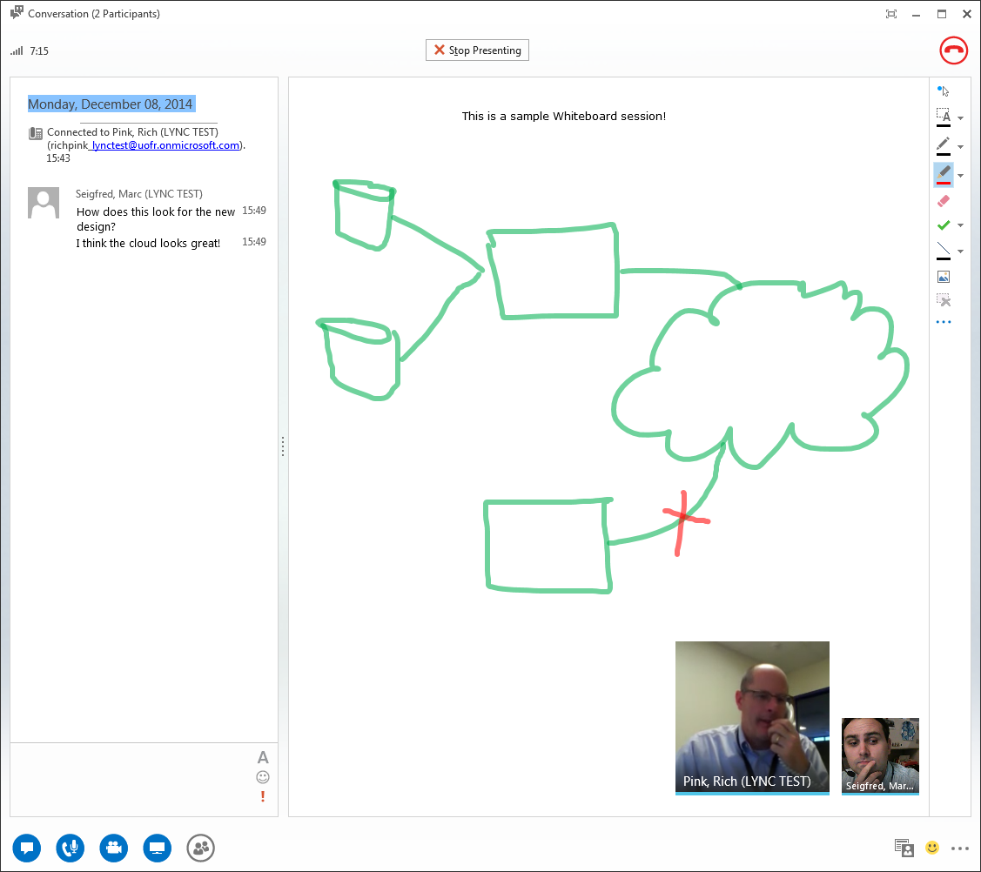
Share a whiteboard
Need to show everyone what you are talking about? Draw it on a whiteboard.
Great for brainstorming!
In the conversation window, press the Present button then choose: More and then choose Whiteboard.
Check out the toolset on the right hand side.
2
Drag files
here to
Share
1

